Slide 1
Architecture of Neural Network
There are basically three types of architecture of the neural network.
Single Layer feedforward network
Multi-Layer feedforward network
Recurrent network

Slide 2
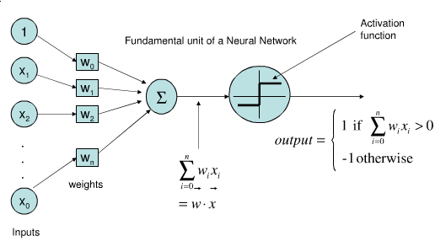
1. Single- Layer Feedforward Network
In this, we have an input layer of source nodes projected on an output layer of neurons. This network is a feedforward or acyclic network. It is termed a single layer because it only refers to the computation neurons of the output layer. No computation is performed on the input layer; hence it is not counted.

Slide 3
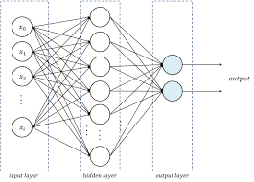
2. Multi-Layer Feedforward Network
In this, there are one or more hidden layers except for the input and output layers. The nodes of this layer are called hidden neurons or hidden units. The role of the hidden layer is to intervene between the output and the external input. The input layer nodes supply the input signal to the second layer’s nodes, i.e. the hidden layer, and the output of the hidden layer acts as an input for the next layer

Slide 4
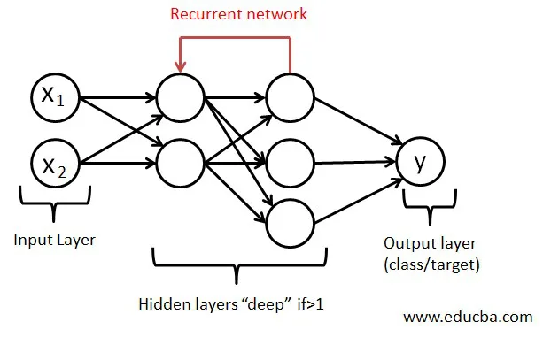
3. Recurrent Networks
A recurrent is almost similar to a feedforward network. The major difference is that it at least has one feedback loop. There might be zero or more hidden layers, but at least one feedback loop will be there.

Slide 5
Advantages of Neural Network
Can work with incomplete information once trained.
Have the ability of fault tolerance.
Have a distributed memory
Can make machine learning.
Parallel processing.
Stores information on an entire network.
Can learn non-linear and complex relationships.
Ability to generaize, i.e. can infer unseen relationships after learning from some prior relationships.

